Slide 1

June 2023
S | M | T | W | T | F | S
 |  |  |  | 1 | 2 | 3
4 | 5 | 6 | 7 | 8 | 9 | 10
11 | 12 | 13 | 14 | 15 | 16 | 17
18 | 19 | 20 | 21 | 22 | 23 | 24
25 | 26 | 27 | 28 | 29 | 30
Notes

Slide 2


JUNE 1, 2023
Content of the day:
Introduction to Spring Framework
History and Evolution of Spring Framework and it's purpose (Dependency Injection, IOC etc.,)

Slide 3

JUNE 2, 2023
Content of the day:
Spring Components, Annotations, MVC
Introduction to ORM, Hibernate Architecture (at High Level)

Slide 4

JUNE 3, 2023
Content for the day:
Introduction to Spring Boot and it's purpose
How Spring and Spring Boot simplifies development
Introduction to WebServices and REST API

Slide 5


JUNE 4, 2023
SUNDAY

Slide 6
JUNE 5, 2023
Content for the day:
Building REST API using Spring Boot
Spring Boot components/aspects
Testing API using postman

Slide 7

JUNE 6, 2023
Content for the day:
Introduction to Microservice, Building Microservices using Spring Boot
Data Modelling using Postgres/NoSQL(MongoDB), JPA

Slide 8

JUNE 7, 2023
Content of the Day:
Spring AOP / Postman API Collaboration
Introduction to CI/CD – Build/Deploy Spring Boot Applications

Slide 9

JUNE 8, 2023
Content of the day:
Data Modelling using PostgreSQL
Data Modelling using NoSQL(MongoDB)
JPA

Slide 10
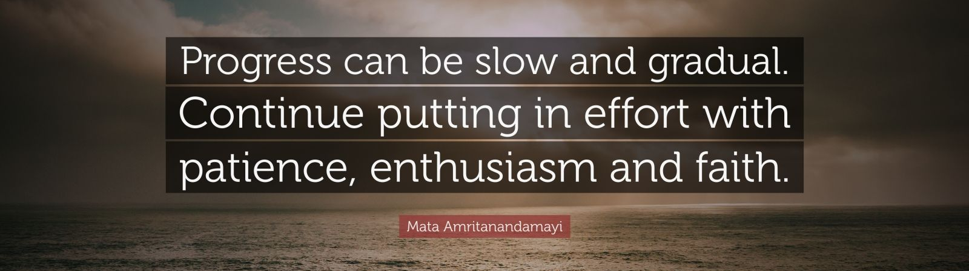
JUNE 9, 2023
Content of the day:
Spring Boot Actuator, Introduction to Spring Cloud (and various Frameworks), Spring Initializer

Slide 11

JUNE 10, 2023
Trainer OFF

Slide 12

JUNE 11, 2023
SUNDAY

Slide 13
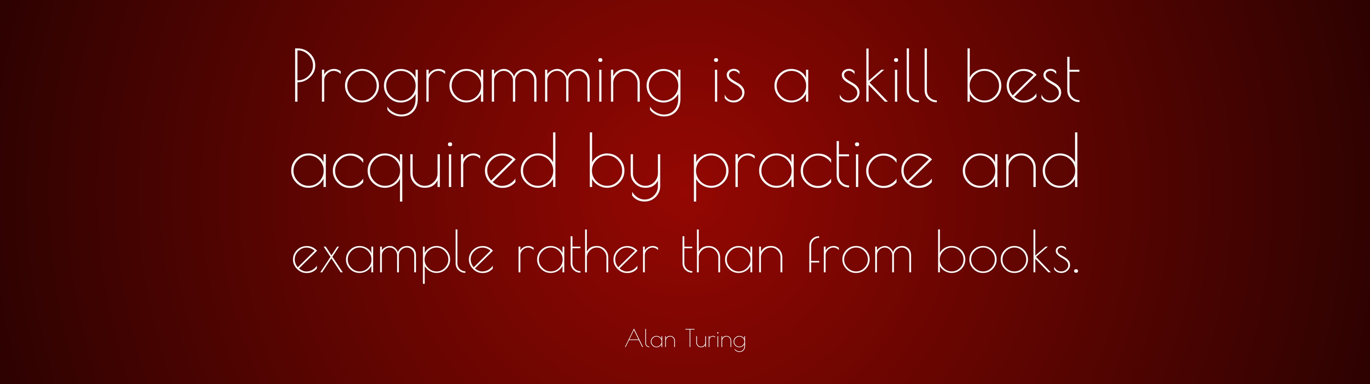
JUNE 12, 2023
Content for the day:
Introduction to AppSecurity, Spring Security, JWT Authentication / OAuth 2.0
Intro to OWASP Top 10
Secure the API, RBA
Swagger Documentation
CORS and FrontEnd + REST API Integration

Slide 14

JUNE 13, 2023
Content of the day:
Recap - Additional aspects, Clarifications
Capstone Project - Design, Build, Review

Slide 15
JUNE 14, 2023
Content of the day
Capstone Project - Design, Build, Review, Approval

Slide 16

JUNE 15, 2023
Content of the day:
Introduction to Cloud computing – Cloud concepts, SaaS / PaaS / IaaS, Private / Public / Hybrid Clouds
Concepts of Cloud Native Development, Virtualization, Cloud Deployment

Slide 17

JUNE 16, 2023
Content of the day:
Introduction to AWS, Security & Identity Management (IAM, Security Group, Policies etc.,),

Slide 18

JUNE 17, 2023
Content for the day:
Introduction to Compute, Storage, Network concepts & Services (S3, EC2, VPC, EBS, Files etc.,)

Slide 19
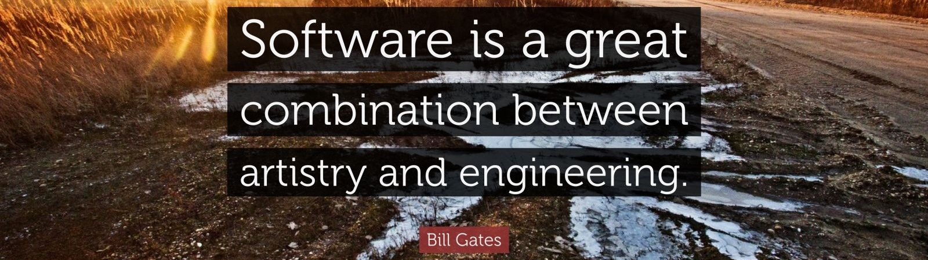
JUNE 18, 2023
SUNDAY

Slide 20

JUNE 19, 2023
Content for the day:
Introduction to AWS RDS related DB Concepts (RDS, DynamoDB overview etc.,)

Slide 21

JUNE 20, 2023
Content for the day:
Introduction to Billing, Cost Optimization, Cloud Watch, Cloud Logs, Best Practices

Slide 22
JUNE 21, 2023
Content of the day:
Build and deploy the sample application to AWS, Elastic Beanstalk

Slide 23

JUNE 22, 2023
Content for the day:
Project Implementation, Collaboration

Slide 24

JUNE 23, 2023
Content of the day:
●Project Implementation, Collaboration

Slide 25

JUNE 24, 2023
Trainer OFF

Slide 26
JUNE 25, 2023
SUNDAY

Slide 27

JUNE 26, 2023
Content for the day:
Project Implementation, Collaboration

Slide 28

JUNE 27, 2023
Content of the day:
Project Implementation, Collaboration

Slide 29
JUNE 28, 2023
Content of the day:
Project Implementation, Collaboration

Slide 30

JUNE 29, 2023
Content for the day:
Project Implementation, Collaboration

Slide 31

JUNE 30, 2023
Content of the day:
Project Presentation, Final Review

